Slide 1
Verilog: Multicore CPU – Matrix Multiplication
Name: Vòng Chí Cường
MSSV: 21521910
TA: Hồ Ngọc Diễm

Slide 2
Table of contents
01
Introduction
03
ISA & Modules
Results Analyzing and Verification
02
Algorithm
04

Slide 3
Introduction
01
You can enter a subtitle here if you need it

Slide 4
Process overview
0
Create random matrices to multiply
01
Convert it to binary stream
10
Implement assembly code for the algorithm to multiply 2 matrices
11
100
101
110
Send the data to the data memory and instruction memory of the system in the FPGA board (via UART)
Matrix multiplication using multi-core processor
Send the answer matrix as a binary data stream to the laptop
Convert binary data to answer matrix
111
Validate the calculation

Slide 5
Processor design flow
0
Design a matrix multiplication algorithm
01
Design the ISA
10
Design the (primitive) Data Path
11
100
101
110
Design the Assembly code
Design the Micro-Architecture
Extend processor design to multi-core processor design
Implement Communication system between FPGA board and the laptop

Slide 6
02
Algorithm

Slide 7
PesudoCode with one Core
Algorithm :
Initialization:
a <- row_P; b <- column_P(row_Q); c <- column_Q;
RP <- start_P, RQ <- start_Q
Mem[6] <- end_P, Mem[7] <- end_Q
Mem[8] <- start_P, Mem[9] <- start_Q, Mem[10] <- start_R
AC, R, RC <- 0
for i = 0; i < a; i ++;
for j = 0; j < c; j ++;
output_value = 0;
for count = 0; count < b; count++;
output_value+ = matrixP[i][count] × matrixQ[count][j];
save matrixR[i; j] <- output_value;

Slide 8
ISA & Modules
03

Slide 9
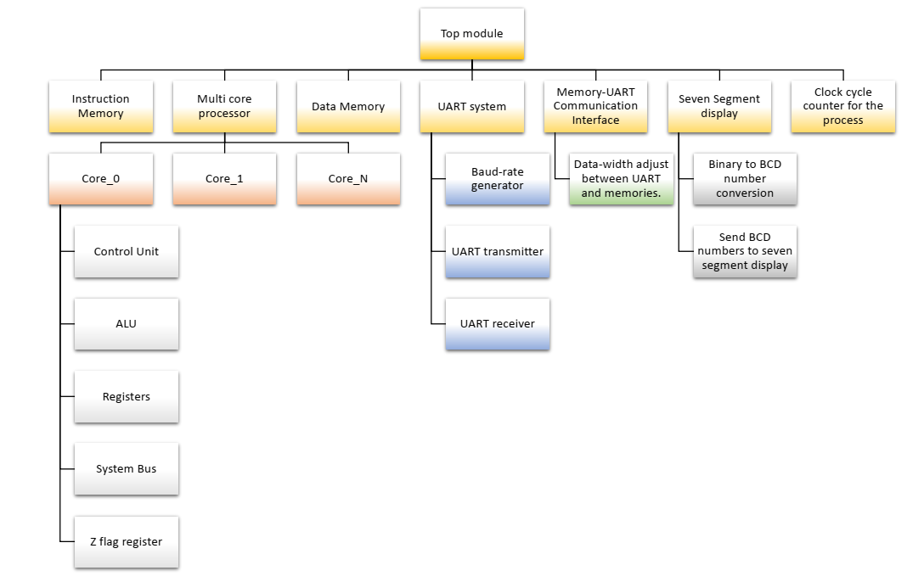
Top Modules

Slide 10
Instruction Set
INSTRUCTION | OPCODE | OPERATION
NOP | 0 | No operation
ENDOP | 1 | End operation
CLAC | 2 | AC 0
LDIAC | 3 | AC dataMemfaddrg
LDAC | 4 | AC dataMemfACg
STR | 5 | dataMemfACg R
STIR | 6 | dataMemfaddrg R
JUMP | 7 | PC instructionMemfaddrg
JMPNZ | 8 | Jump if z!=0
JMPZ | 9 | Jump if z==0
MUL | 10 | AC AC*R1
ADD | 11 | AC AC+R
SUB | 12 | AC AC-RC
INCAC | 13 | AC AC+1
MV RL AC | 14 | RL AC
MV RP AC | 15 | RP AC
MV RQ AC | 16 | RQ AC
MV RC AC | 17 | RC AC
MV R AC | 18 | R AC
MV R1 AC | 19 | R1 AC
MV AC RP | 20 | AC RP
MV AC RQ | 21 | AC RQ
MV AC RL | 22 | AC RL

Slide 11
Memory Locations of Some Necessary Data Values
0 | a | No. of rows of matrix P
1 | b | No. of columns of matrix P (No. of rows of matrix Q)
2 | c | No. of columns of matrix Q
3 | start addr P | Start address of matrix P
4 | start addr Q | Start address of matrix Q
5 | start addr R | Start address of matrix R
6 | end addr P | End address of matrix P
7 | end addr Q | End address of matrix Q
8 | current addr P | The address of currently processing data of matrix P
9 | current addr Q | The address of currently processing data of matrix Q
10 | current addr R | The address of currently processing data of matrix R
11 | current c | Current row count
12 | current a | Current column count

Slide 12
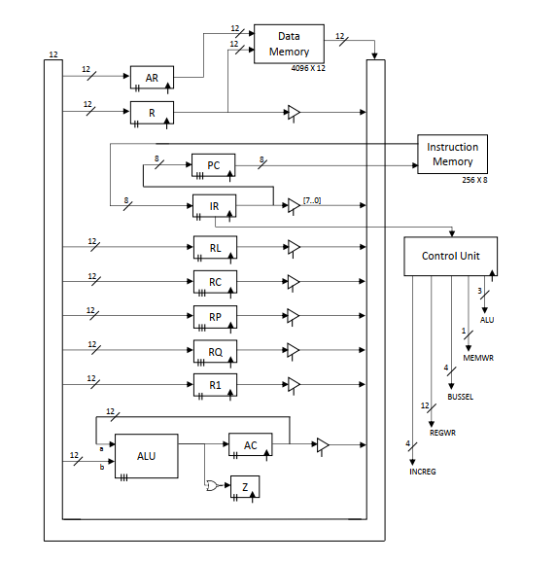
Datapath of CPU

Slide 13
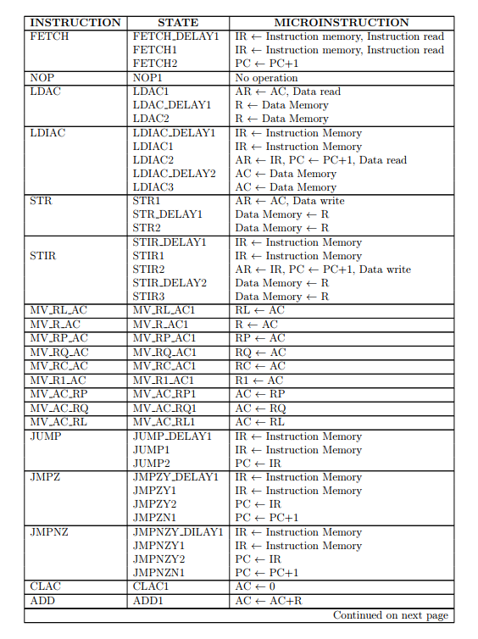
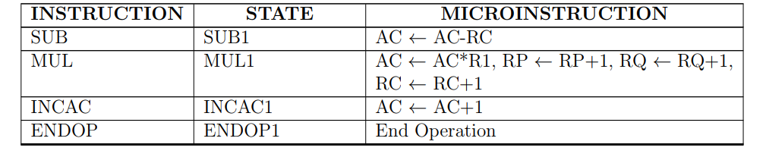
Micro-instructions

Slide 14
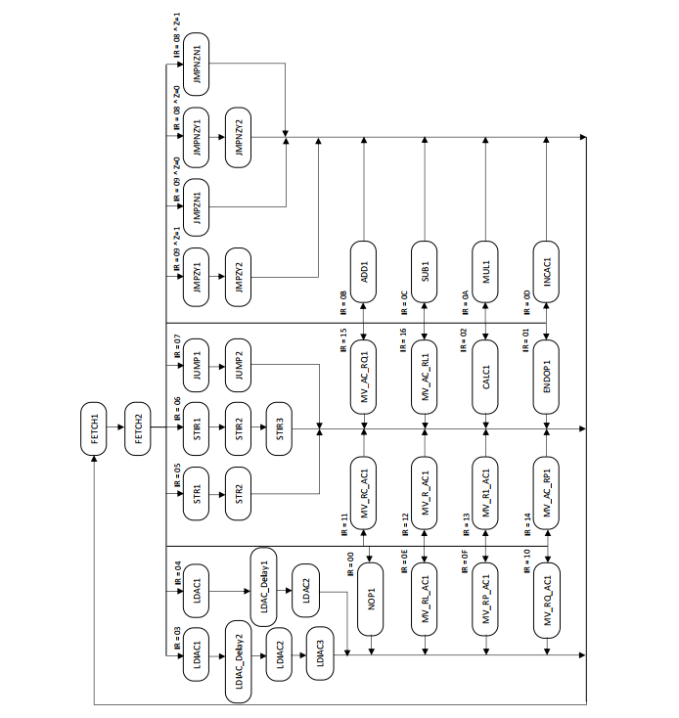
State Diagram

Slide 15
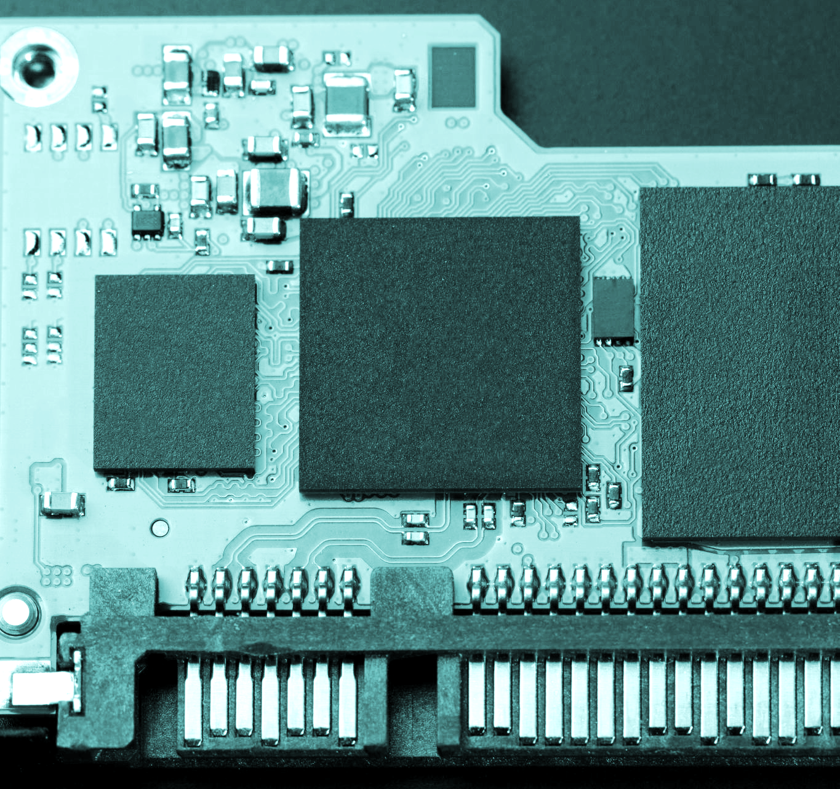
Summary of Verilog

Slide 16

What is “gotcha” ?
Examples
Definition
A programming "gotcha" is a language feature, which, if misused, causes unexpected-and, in hardware design, potentially disastrous-behavior

Slide 17
Gotcha
In hardware design and verification, most gotchas will simulate, but give undesired results
Gotchas can be difficult to find and debug 
A gotcha can be disastrous if not found before tape-out!

Slide 18

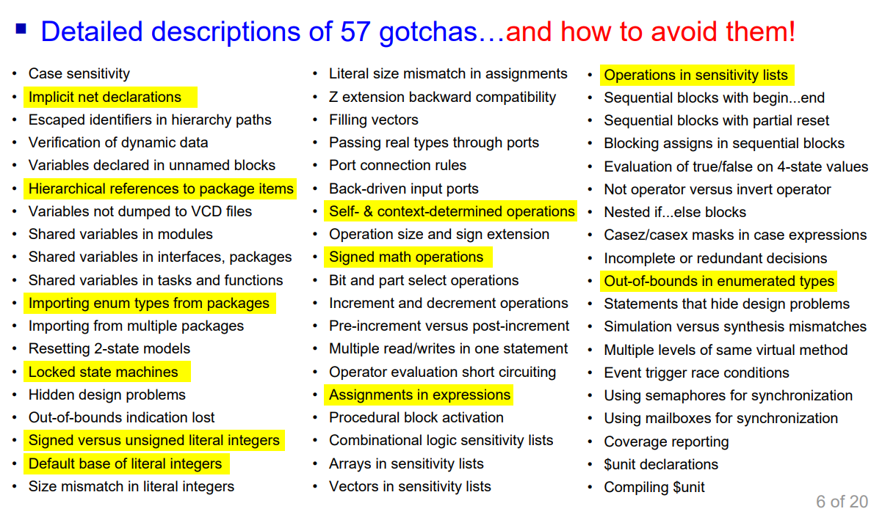

Slide 19
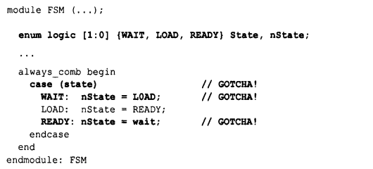
Case sensitivity
Verilog and SystemVerilog are case-sensitive languages, meaning that lowercase letters and uppercase letters are perceived as different in identifiers and in keywords.
Keywords are always in all lowercase letters

Slide 20
Implicit Net Declarations
An undeclared signal used in a netlist infers an implicit net
Implicit nets can save typing hundreds of lines of code in a large, gate-level design.
But…
An undeclared vector connection infers a 1-bit wire, not a vector;
A typographical error in a netlist becomes a functional bug

Slide 21
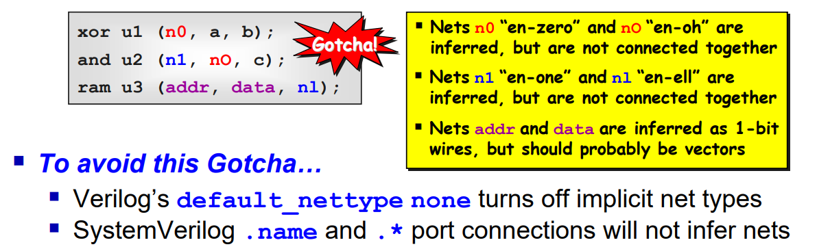
Implicit Net Declarations

Slide 22
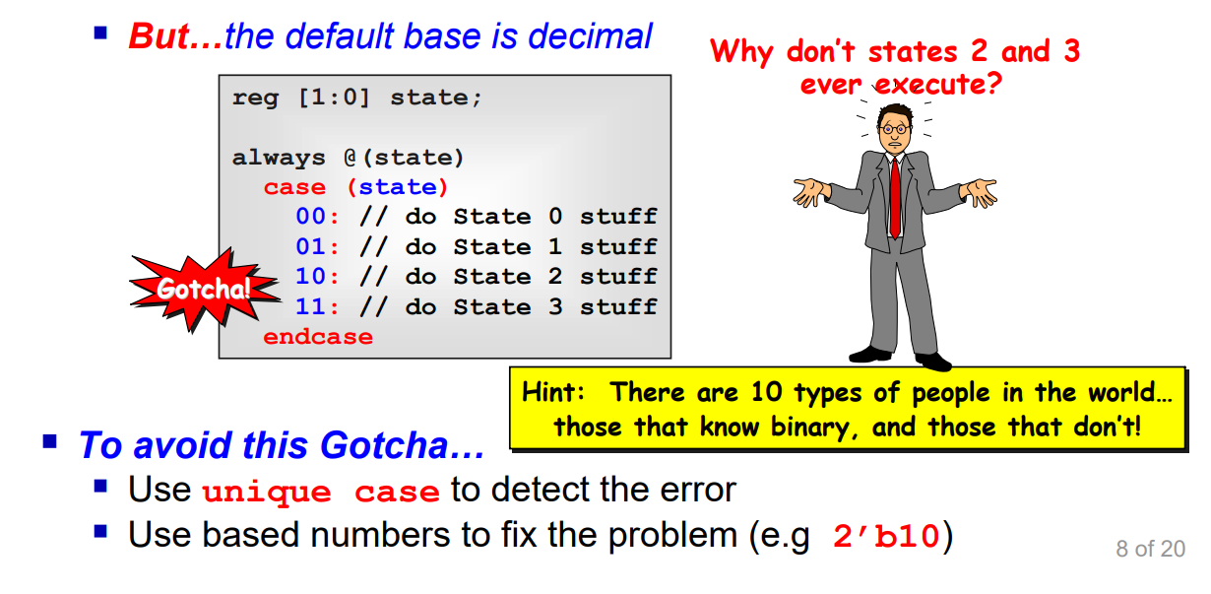
Default Base of Literal Numbers is Decimal
Programming
Gotcha
Optionally, literal numbers can be defined with a base
’hC // unsized hex value
2’b01 // sized binary value

Slide 23
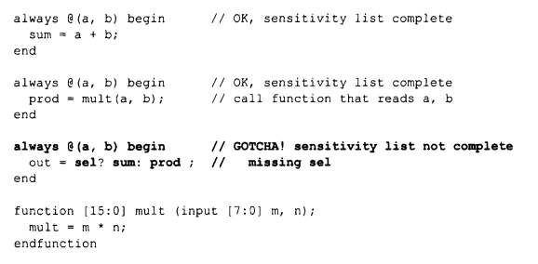
Combinational logic sensitivity lists with function calls
Gotcha: My combinational logic seemedto simulate OK, but aftersynthesis, thegate-level simulation does notmatch the RTLsimulation.
Synopsis: If combinational logic calls a function, then the combinational sensitivity list must include signals that thefunction reads. @* does not infer sensitivity to values readbyfunctions calledfrom combinational logic

Slide 24
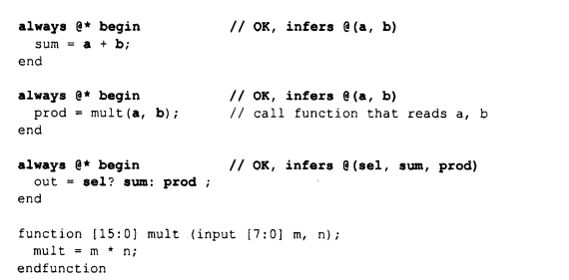
We find solutions…
Using @*
The @* wildcard will automatically be sensitive to any nets or variables that are read in the always procedural block, including any nets or variables that are passed to a function input.

Slide 25
We find solutions…
module MyModule(input wire a, input wire b, output wire c);
always @* begin
c = myFunction(a, b);
end
function logic myFunction(input wire x, input wire y);
logic result;
// Some logic using x and y
// ...
return result;
endfunction
endmodule
However, @* has a subtle gotcha that is not widely known. It only infers sensitivity to signals directly referenced in the always block. It will not infer sensitivity to signals that are externally referenced in a function that is called from the always block. That is,the @* will only be sensitive to thesignals passed into the function or task.

Slide 26
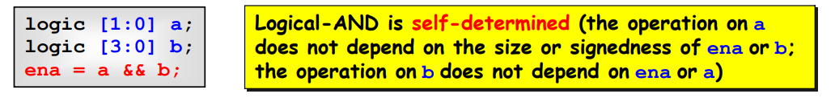
Operation Size and Sign Extension
Self-determined operators : do not modify their operand(s)

Slide 27
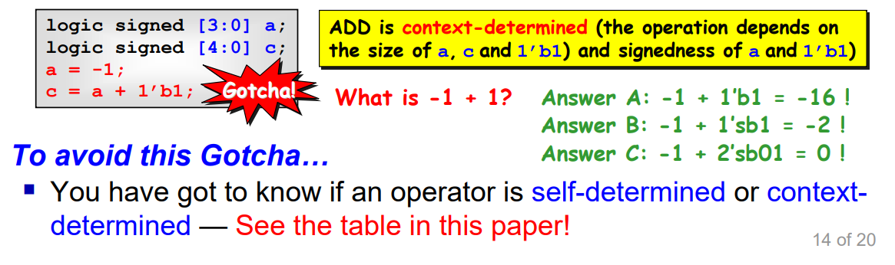
Operation Size and Sign Extension
Context-determined operators : modify all operands to have the same size, using zero-extension or sign-extension

Slide 28
References
Verilog and SystemVerilog Gotchas
101 Common Coding Errors and How to Avoid Them --- Verilog and SystemVerilog Gotchas: 101 Common Coding Errors and How to Avoid Them | SpringerLink
Standard Gotchas Subtleties in the Verilog and SystemVerilog Standards That Every Engineer Should Know
--- Standard Gotchas (lcdm-eng.com)

Slide 29
Thank you for watching

